Slide 1
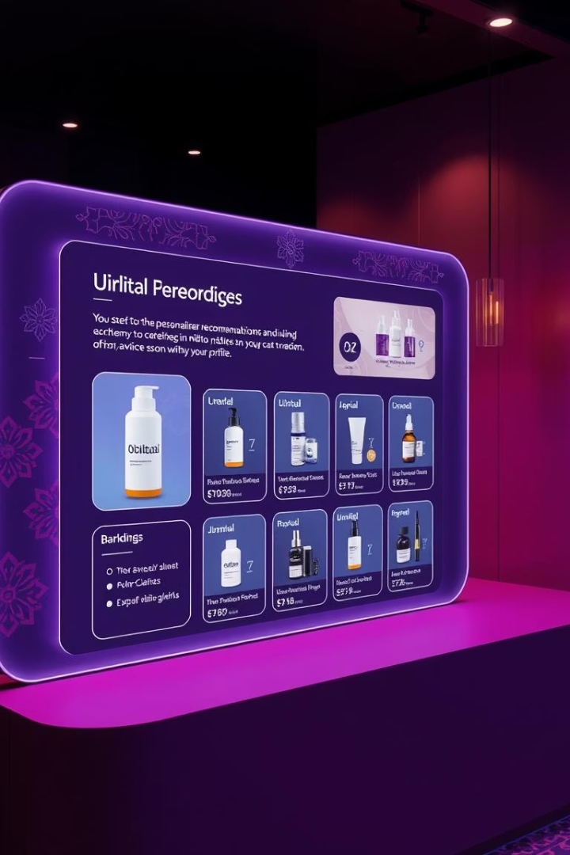

Elowen: Bloom - Project Summary
Elowen Bloom is a digital platform offering personalized skincare, haircare, and beauty guidance. It is specifically tailored for Indian users, addressing their unique skin and hair types through a website and app.
by Sri Ragini Mulagala

Slide 2
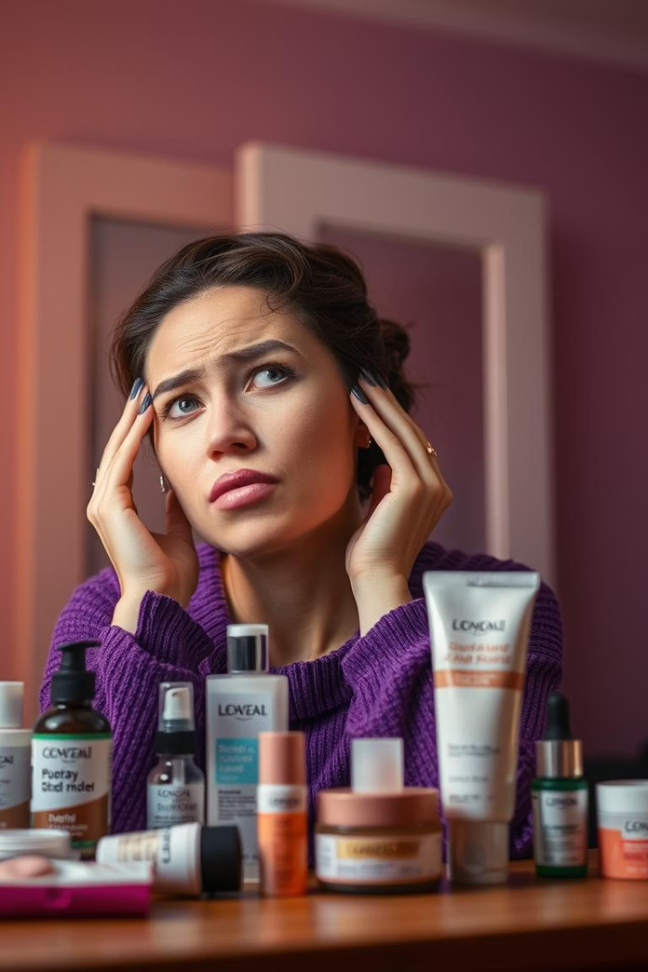



The Problem: Generic Beauty Routines Fail
Diverse Needs
Routine Issues
India's varied climate, skin, and hair types demand personalized care.
Generic routines often cause significant skin and hair problems.
Lack of Awareness
Users often lack knowledge about suitable products and ingredients.
The Indian beauty and personal care market is estimated at $26.8 billion in 2023. This highlights a massive opportunity for tailored solutions.

Slide 3
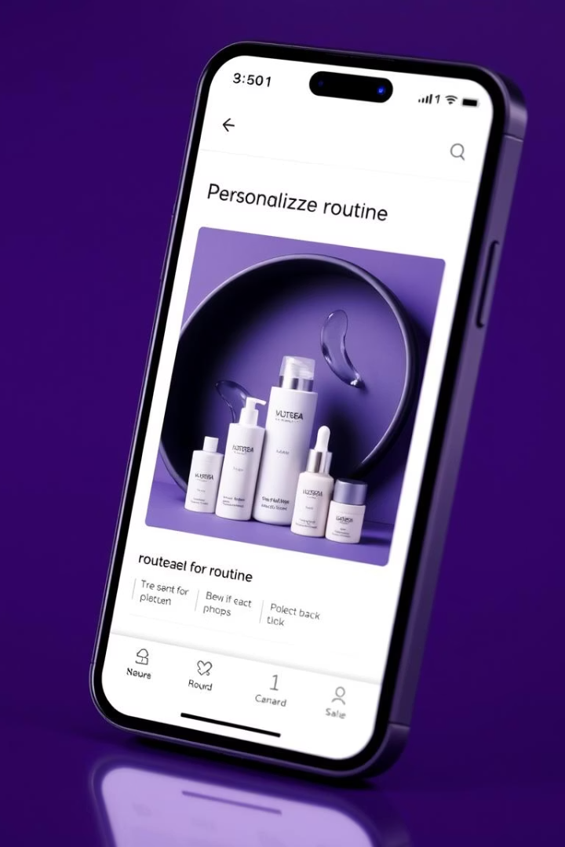




The Solution: Elowen Bloom
Personalized Routines
Customized care plans based on individual user profiles.
Expert Content
Guidance on both natural and scientific beauty treatments.
Interactive Tools
Advanced skin and hair analysis features for precise recommendations.
Regional Language Support
Enhanced accessibility with content available in local languages.

Slide 4





Key Features
AI Analysis
Product Match
Virtual Consults
AI-powered skin and hair diagnosis.
Personalized product recommendations.
Online sessions with experts.
E-commerce
Integrated platform for easy purchases.
These features create a holistic and user-centric beauty experience. They empower users to make informed choices.

Slide 5

Target Audience
Demographics
Indian women aged 18-45.
Location
Urban and semi-urban residents with internet access.
Mindset
Seeking personalized beauty solutions.
Behavior
Early adopters of digital beauty services.
This segment represents a significant and growing market. They are actively seeking tailored solutions for their beauty needs.

Slide 6

Business Model
Freemium Model
Basic features are free for all users. Premium subscriptions unlock advanced analysis and consultations.
Affiliate Marketing
Elowen Bloom earns commissions on product sales made through the platform.
Strategic Partnerships
Collaborations with leading local and international beauty brands.
Projected first-year revenue is set at $500,000, demonstrating strong growth potential.

Slide 7








Marketing Strategy
Digital Marketing
Content Marketing
SEO, vibrant social media campaigns, and influencer collaborations drive visibility.
Engaging blogs, informative videos, and interactive webinars build authority.
Trust Building
Strategic Partnerships
Focus on establishing Elowen Bloom as a trusted authority in the Indian market.
Collaborations with beauty salons and spas expand reach and credibility.
This multi-faceted approach ensures comprehensive market penetration and brand loyalty. It leverages various channels to reach the target audience effectively.

Slide 8
Conclusion
Addressing Needs
1
Elowen Bloom fulfills a vital need for personalized beauty in India.
Scalable Growth
2
The business model supports expansion and future development.
Competitive Edge
3
Personalization and localization provide strong advantages.
Elowen Bloom is poised to revolutionize the Indian beauty industry. It offers tailored solutions to a vast and underserved market.

